Slide 1
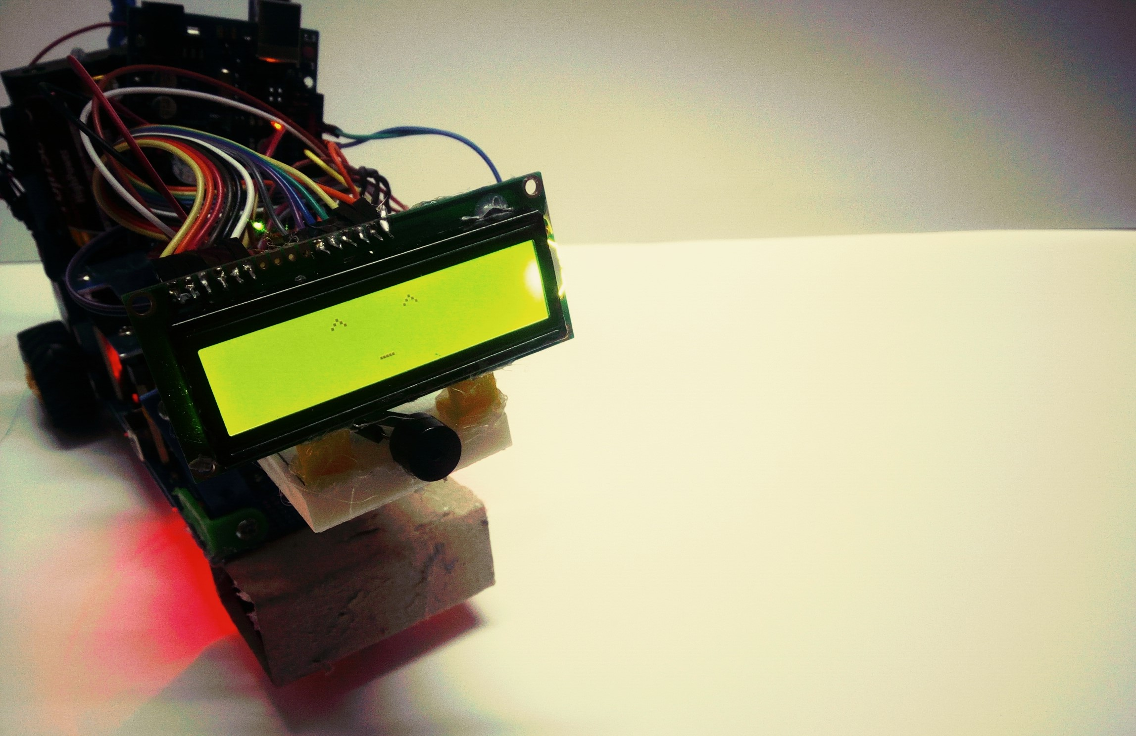
K-9
Voice Controlled & Communicating ROBOT
<Group 12>
Credits: - Program: Yuki Yoshida, Seina Taguchi, Bach Nguyen
- Android app (Robot controller): Vinh Nguyen
- Hardware: Bach Nguyen

Slide 2
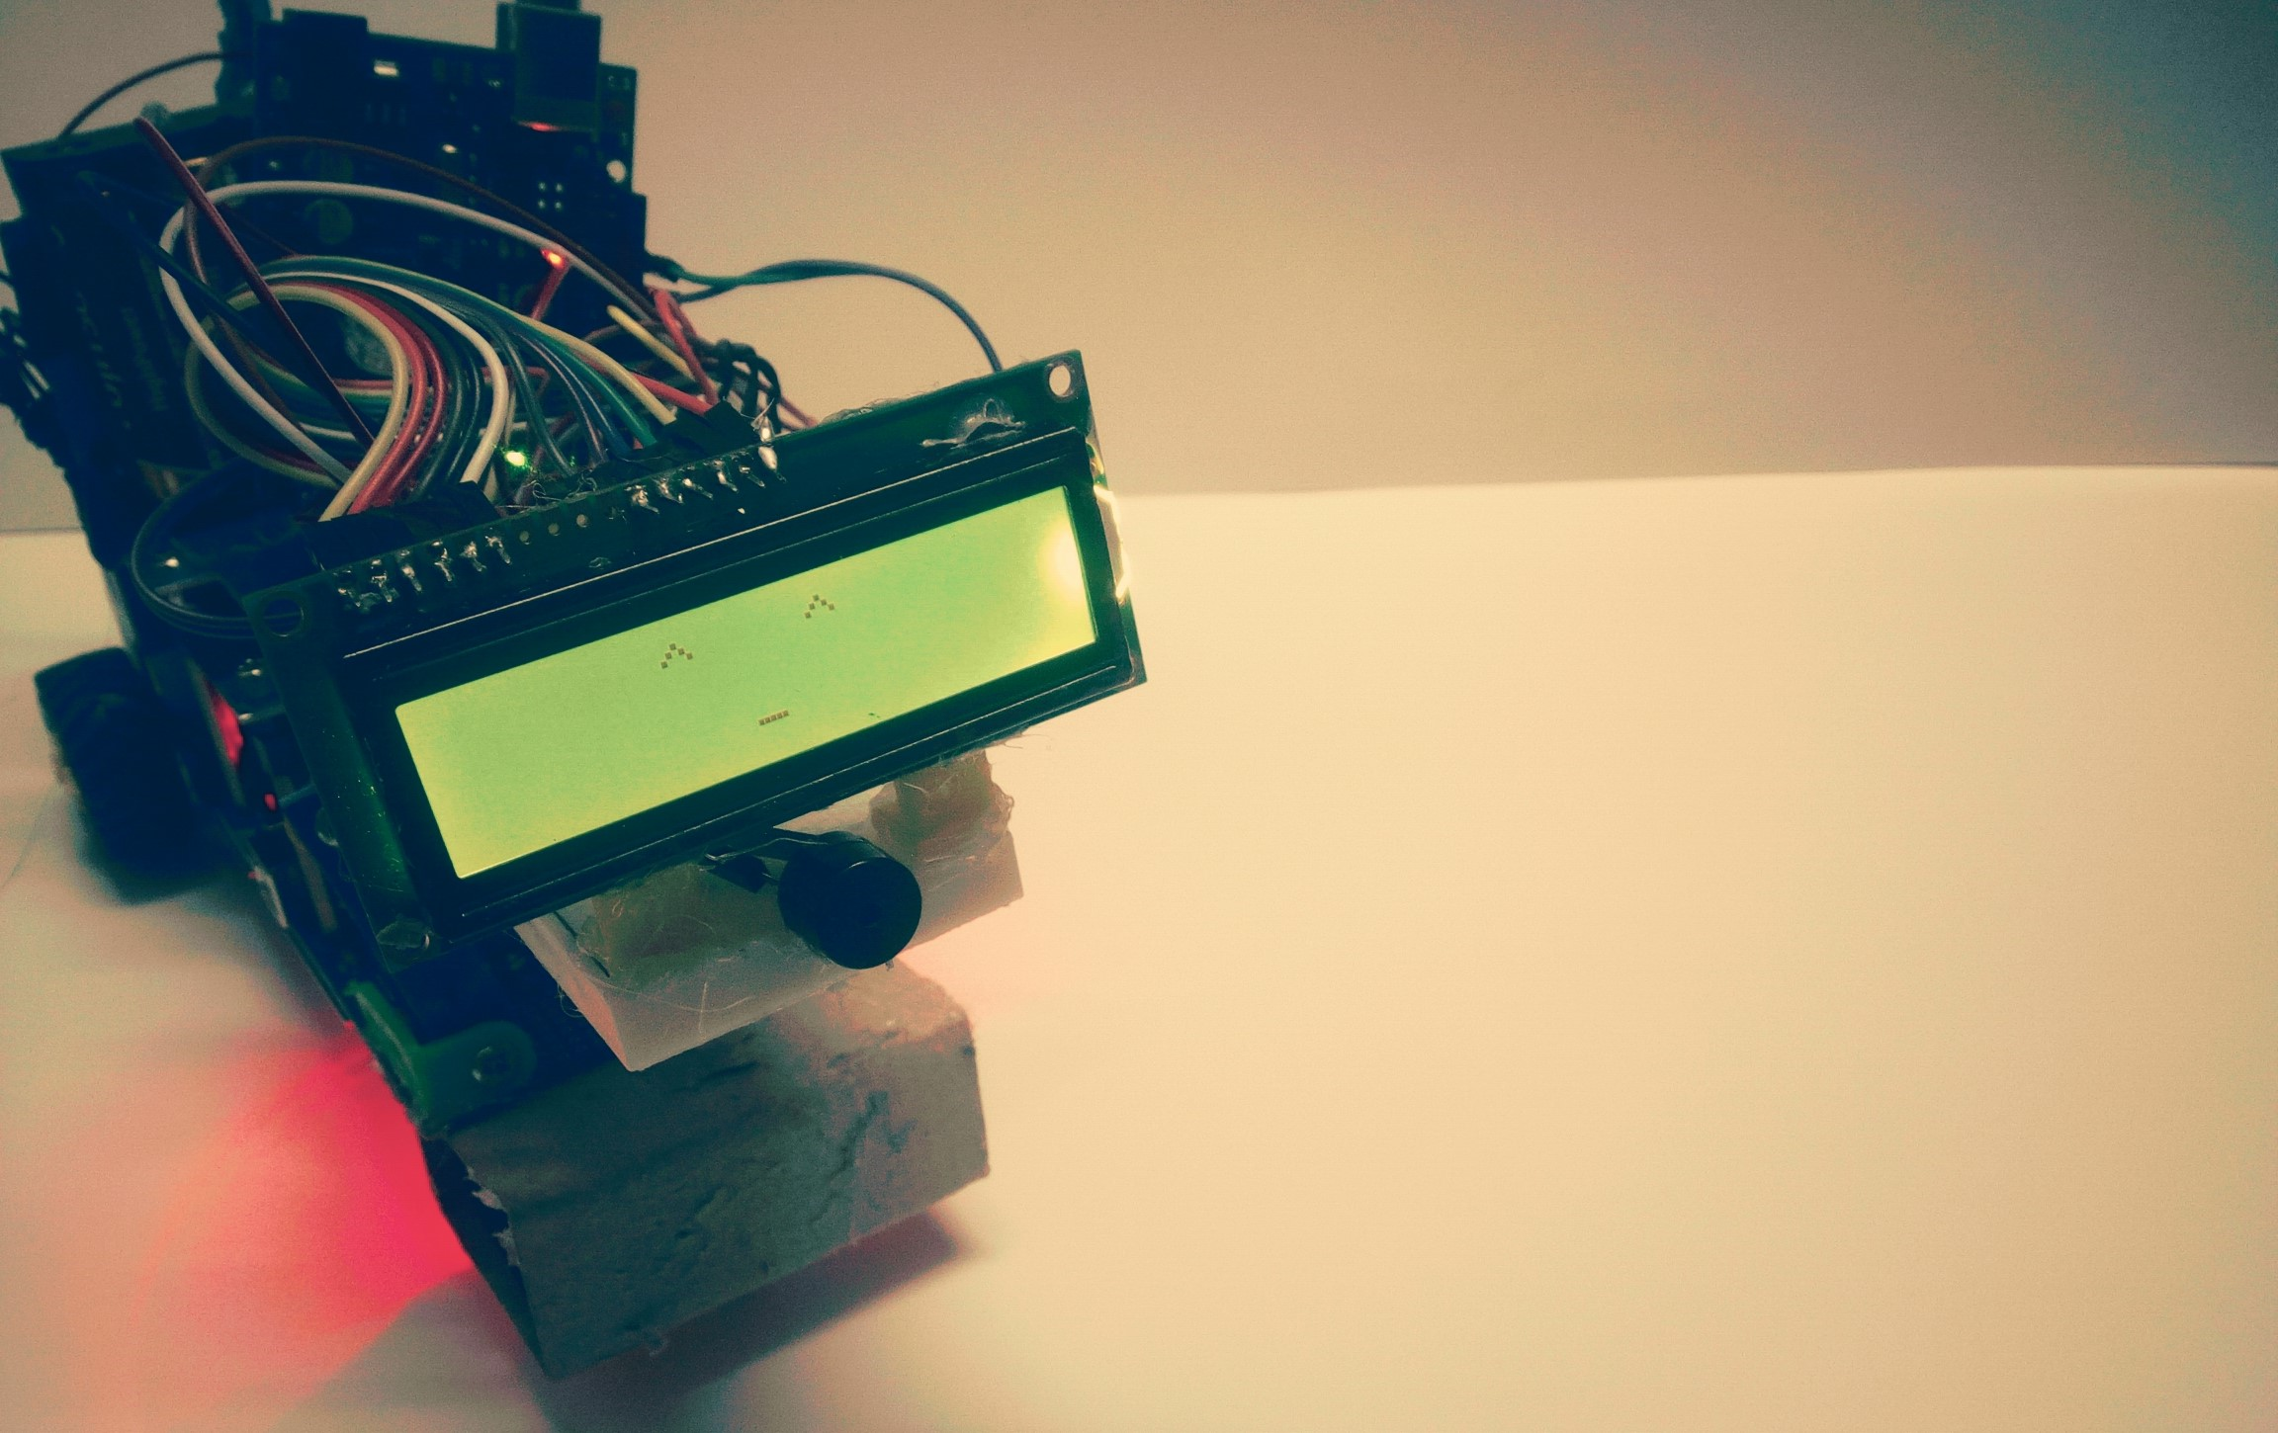
WHY?

Slide 3
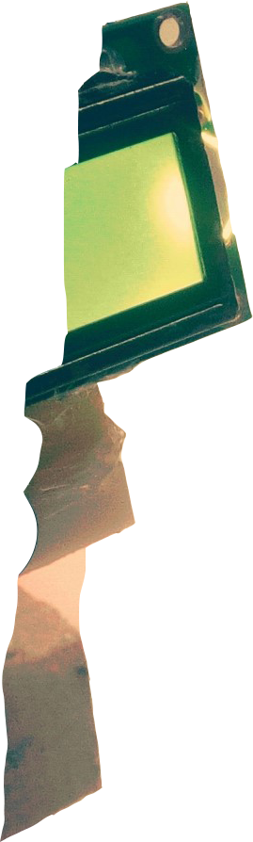
BASIC OPERATIONS
Voice control (Bluetooth)
Button control (Bluetooth)
Communicate (LCD & Piezo)

Slide 4
ROBOT CONTROLLER (Android app)

Slide 5
CODE

Slide 6
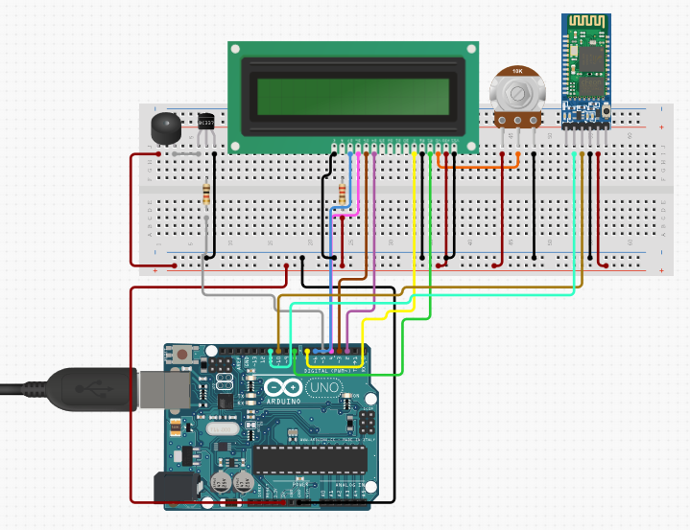
HARDWARE DESIGN

Slide 7
THANKYOU FOR WATCHING!

